Slide 1


OMENN
One Matrix To Explain Neural Networks
Adam Wróbel, Mikołaj Janusz,
Bartosz Zieliński, Dawid Rymarczyk

Slide 2
Agenda
Background & Motivation
Method Overview
Core Mechanisms
Experimental Results
Conclusions

Slide 3
Background & Motivation

Slide 4
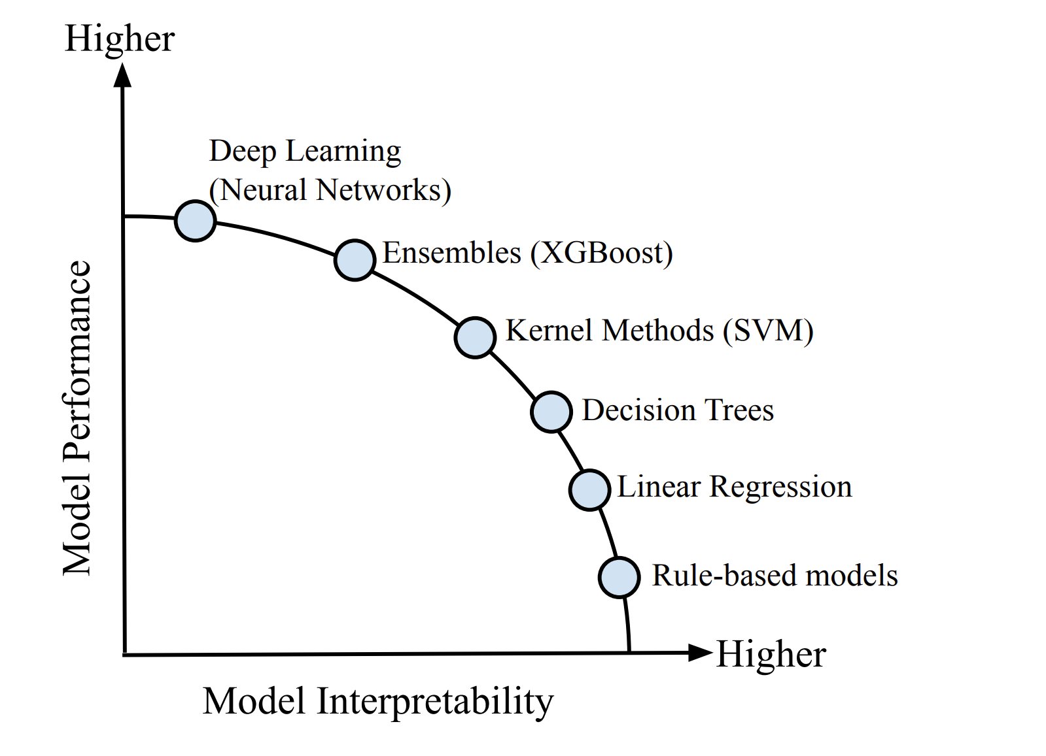
Background
Modern AI relies on "black box" neural networks, making their decisions difficult to understand.
Notes:
modern AI is based on neural networks which are “black box”, this means that it’s hard to understand why the model made a specific decision
simpler methods are more interpretable, there is an interpretability to performance tradeoff which is visible on the slide

Slide 5
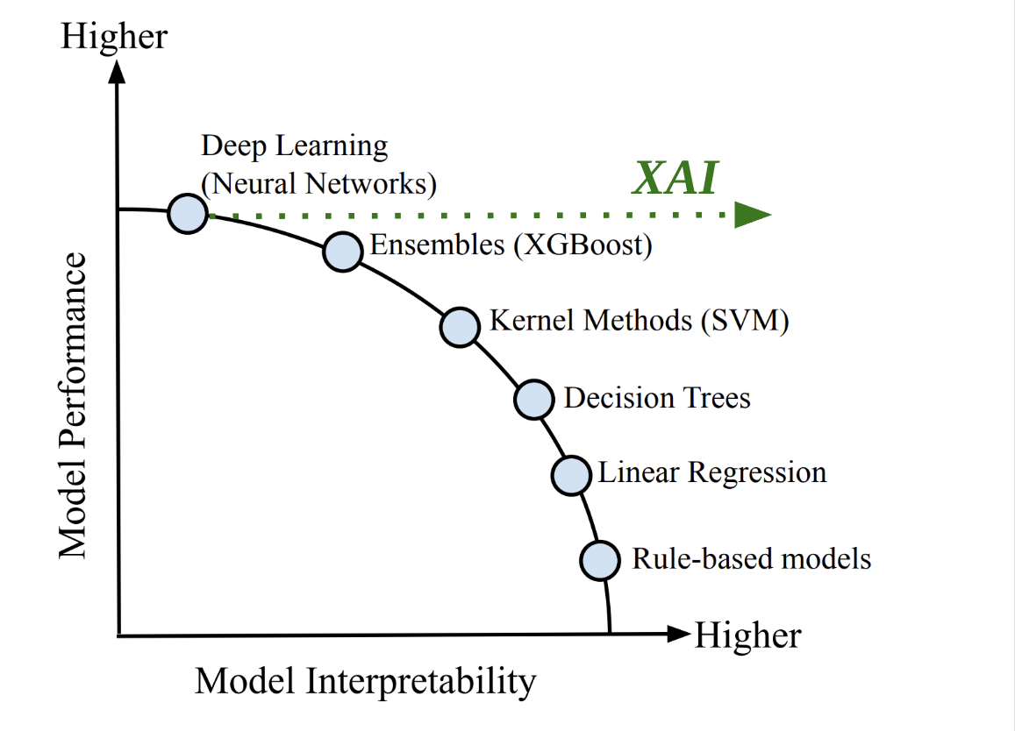
Background
Modern AI relies on "black box" neural networks, making their decisions difficult to understand.
Explainable AI (XAI) field has emerged to make these "black box" models more transparent.
Notes:
A field of explainable AI emerged to try make these black box models more transparent and understand the mechanisms behind model decisions.
it can be visualized on the graph as moving the neural network into higher intepretability.
But we don’t want to lose performance!

Slide 6
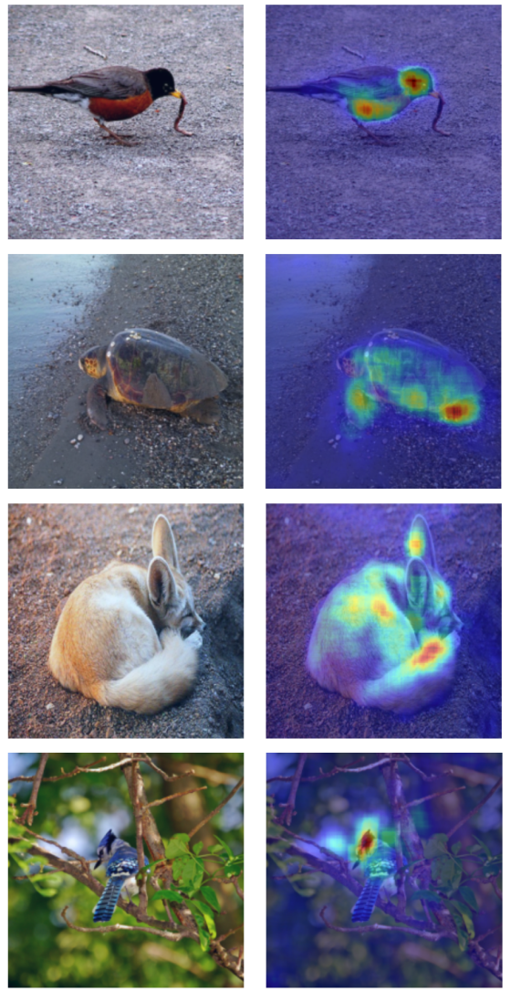
Background
Modern AI relies on "black box" neural networks, making their decisions difficult to understand.
Explainable AI (XAI) field emerged to make these "black box" models more transparent.
Among XAI techniques are Attribution Methods, which highlight the most important input features.
Notes:
Among these explainable AI techniques are attribution methods. They highlight the input features. We can see an example on the slide.
The problem is if these features are trustworthy.

Slide 7
Motivation
The Gap: Many attribution methods are approximations based on local gradients. They can be unfaithful and fail in common scenarios like saturated activations, leading to misleading explanations.
Notes:
So these methods often have a problem that they use approximations which can be unfaithful.

Slide 8
Motivation
The Gap: Many attribution methods are approximations based on local gradients. They can be unfaithful and fail in common scenarios like saturated activations, leading to misleading explanations.
Research Goal: to develop a post-hoc method that provides a precise and complete explanation, directly analyzing the model's computation.
Notes:
Our goal was to develop a post-hoc method (meaning we can use that on already trained model without change to architecture).
It should be precise and show exact computation.

Slide 9
Motivation
The Gap: Many attribution methods are approximations based on local gradients. They can be unfaithful and fail in common scenarios like saturated activations, leading to misleading explanations.
Research Goal: to develop a post-hoc method that provides a precise and complete explanation, directly analyzing the model's computation.
OMENN Core Idea: exactly decompose the entire network's computation for a specific input and captures it into a single matrix.
Notes:
So we want to decompose the matrix computation for a specific input (that’s important) and capture that into a single matrix.

Slide 10
Method Overview

Slide 11
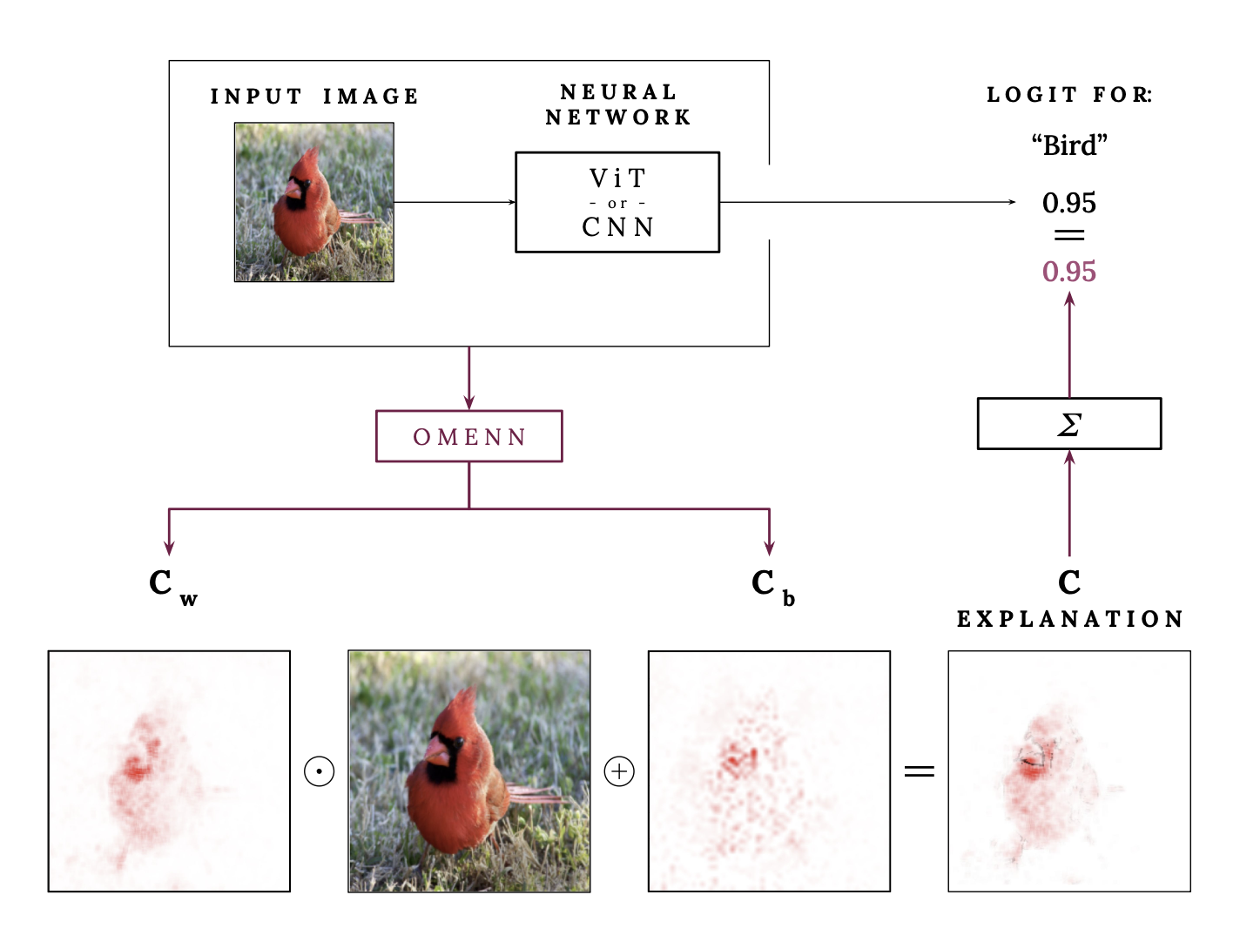
Overview
As stated before, Neural networks are “black-boxes”.

Slide 12
Overview
We can use XAI methods like OMENN to explain the decision.

Slide 13
Overview
OMENN creates matrices which capture weight C_{W} & bias C_{b} contributions.

Slide 14
Overview
These matrices can be combined with the input to get the explanation.

Slide 15
Overview
The explanation adds up to the network’s output.
It doesn’t add or remove extra information.

Slide 16
Core Mechanisms

Slide 17
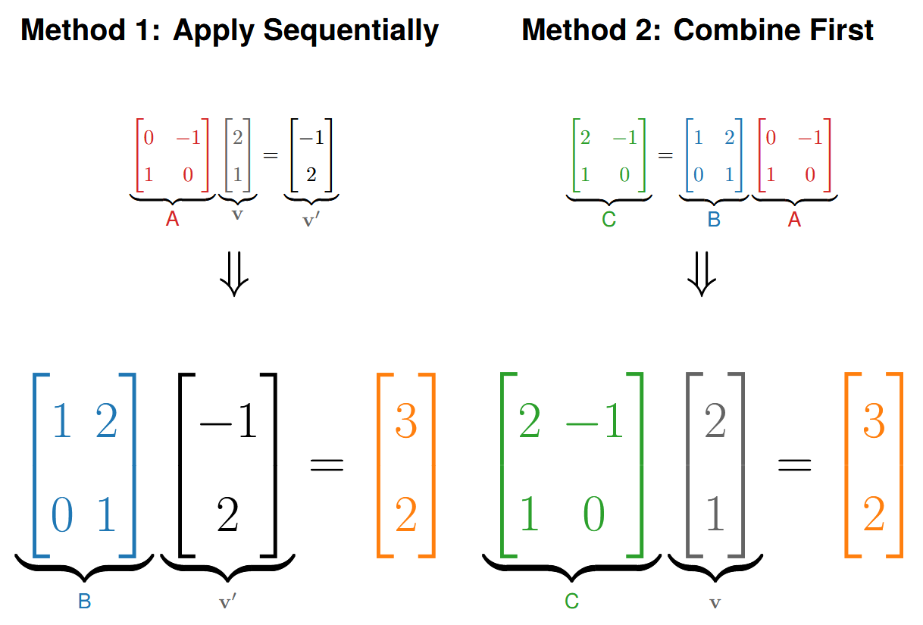
Reminder - Linearity
Linear transformations can be combined into a single transformation.

Slide 18
Reminder - Linearity
Linear transformations can be combined into a single transformation.
This is due to associative property of matrix multiplication:
B * (A * v) = (B * A) * v

Slide 19
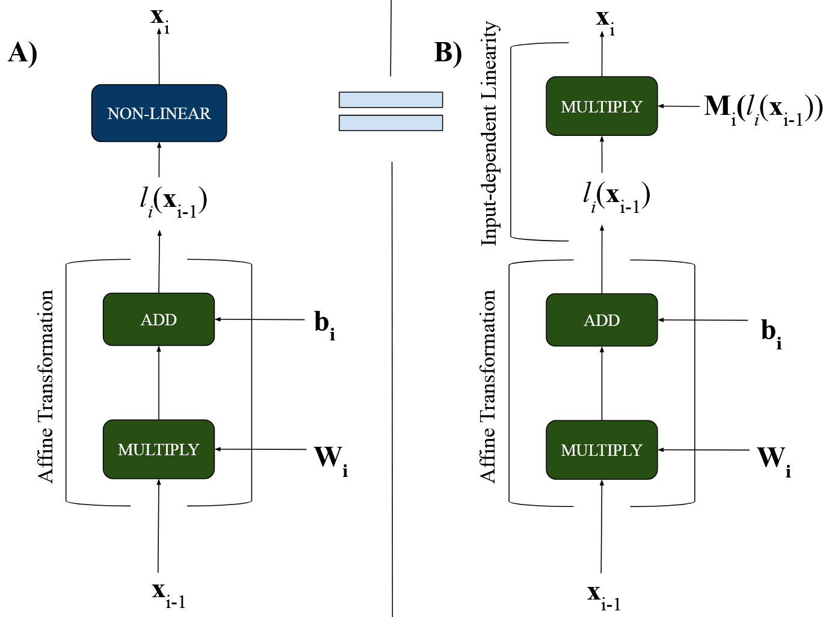
Input-dependent Linearity
A standard network block: an affine transformation followed by a non-linear one.

Slide 20
Input-dependent Linearity
A standard network block: an affine transformation followed by a non-linear one.
Idea: replace the non-linearity with an equivalent multiplication by an input-dependent matrix.

Slide 21
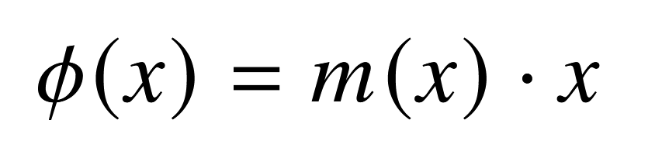
Input-dependent Linearity
An activation layer ReLU can be easily described in an input-dependent form.

Slide 22
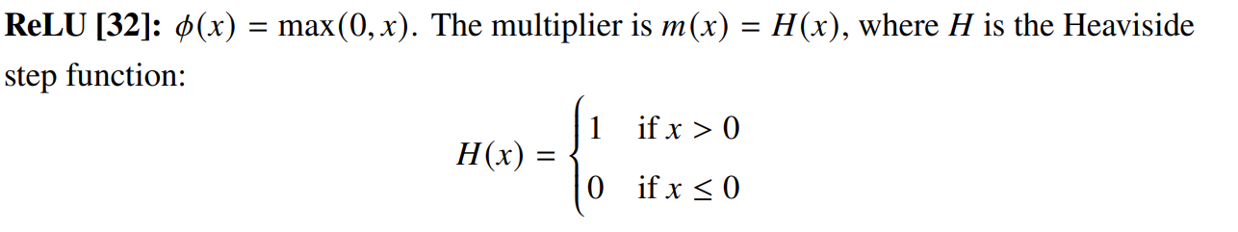
Input-dependent Linearity
An activation layer ReLU can be easily described in an input-dependent form.
Notes:
GELU activation layer is more complex, other layers like Dot-Product Attention, LayerNorm or skip connections are detailed in the paper.

Slide 23
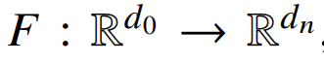
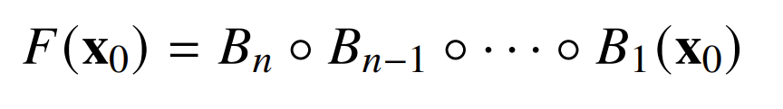
Network Decomposition
A neural network can be described as a composition of blocks of transformations B

Slide 24
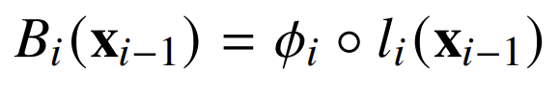
Network Decomposition
A neural network can be described as a composition of blocks of transformations B
The present non-linearities ϕ (ReLU, GELU…) prevent merging into one matrix.

Slide 25
Network Decomposition
A neural network can be described as a composition of blocks of transformations B
The present non-linearities ϕ (ReLU, GELU…) prevent merging into one matrix.
However, we can replace the non-linearity ϕ with an input-dependent linearity.

Slide 26
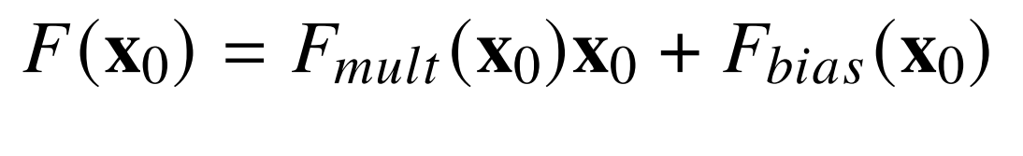
Network Decomposition
Through input-dependent linearity, we can transform the network blocks and combine them to get the network output in the given form:

Slide 27
Network Decomposition
Through input-dependent linearity, we can transform the network blocks and combine them to get the network output in the given form:
Where F_{mult} and F_{bias} can be used to construct weight C_{W} and bias C_{b} matrices.

Slide 28
Network Decomposition
With weight C_{W} and bias C_{b} matrices, we can construct the final explanation.

Slide 29
Results

Slide 30
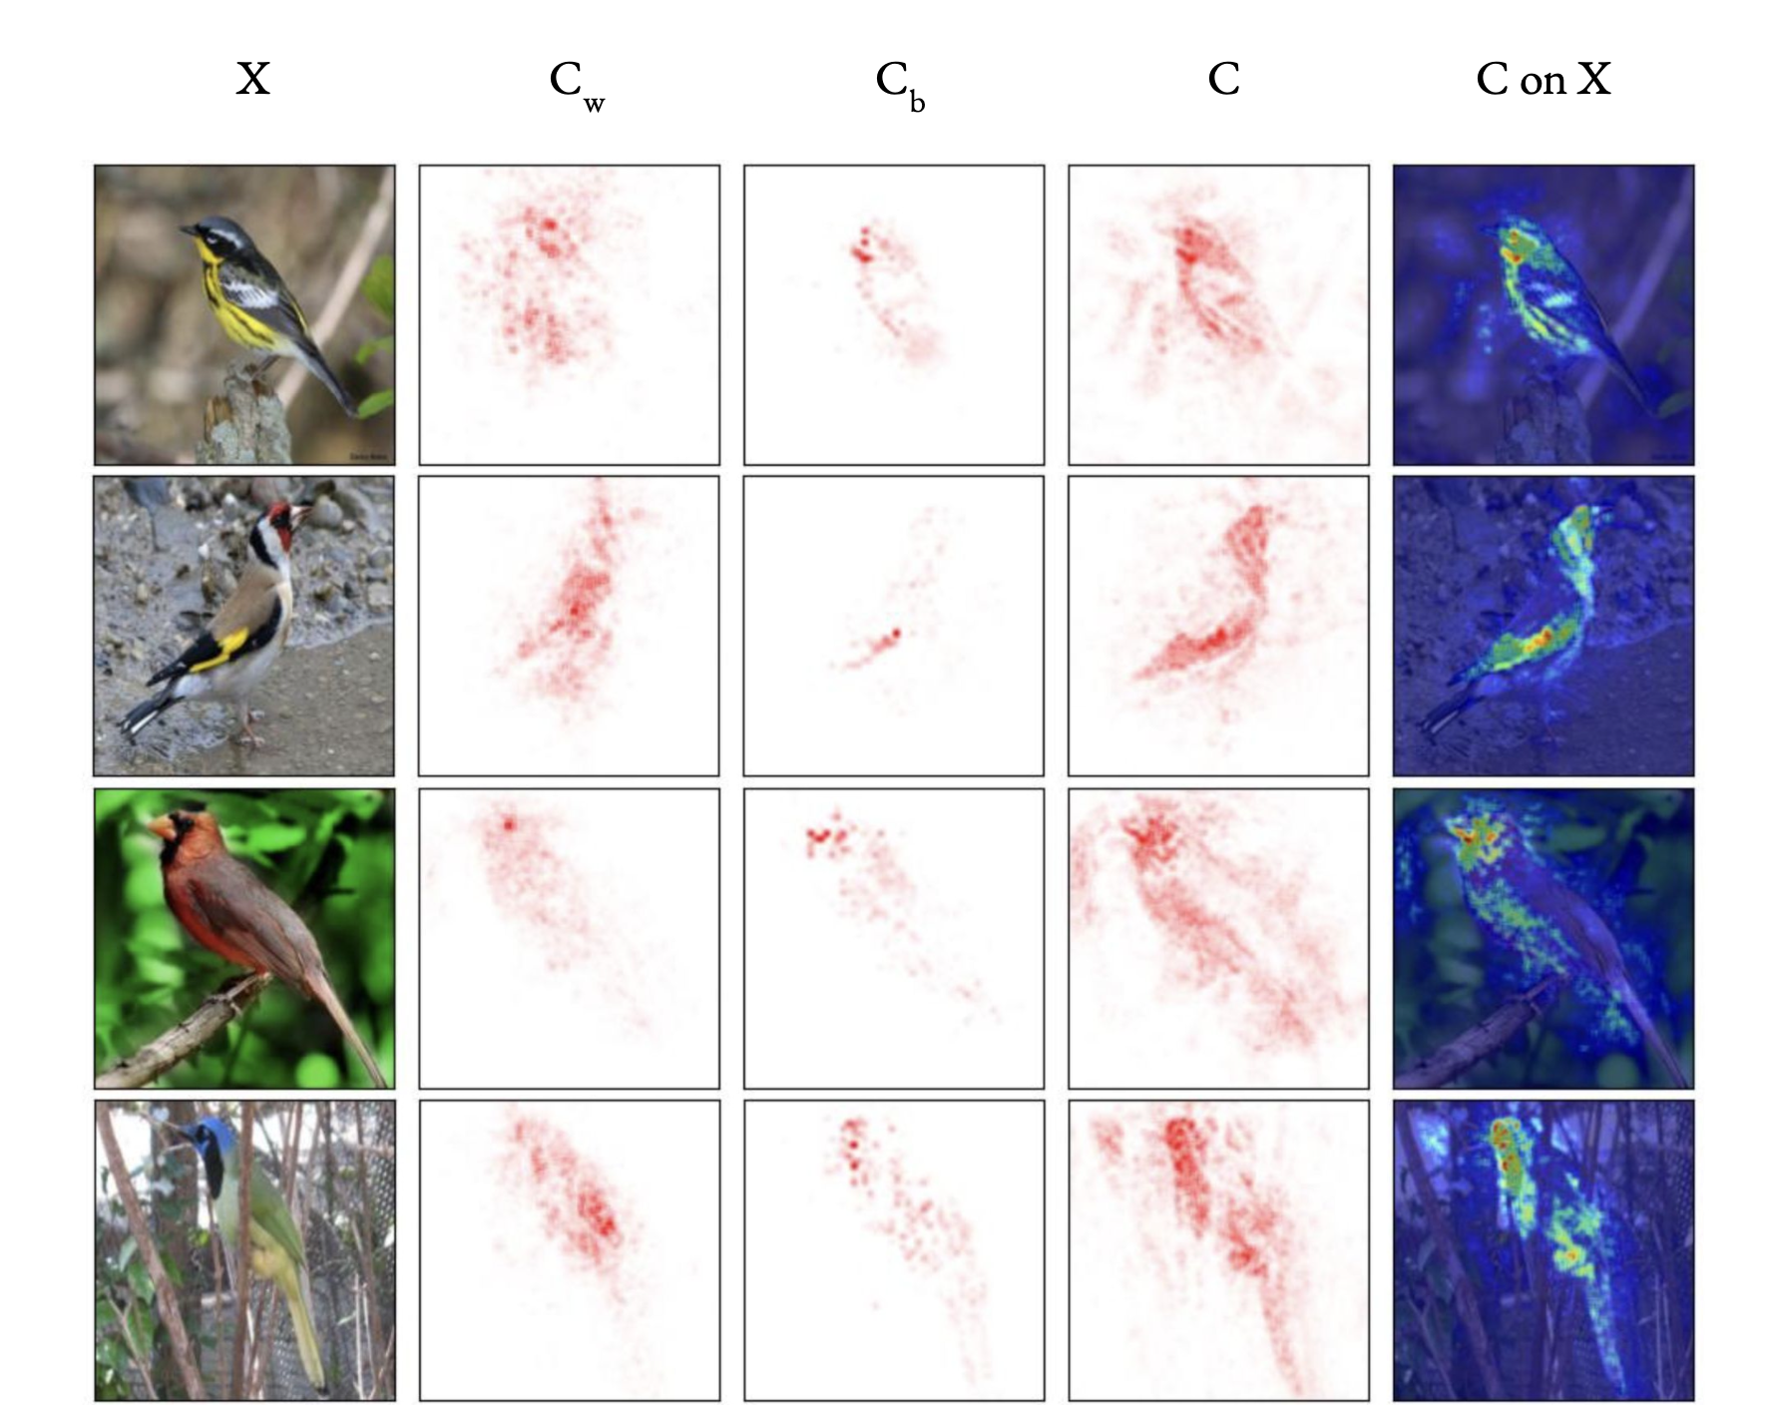
Results - Visual
Visualization of the OMENN components on CUB-200 dataset with ConvNext backbone.

Slide 31
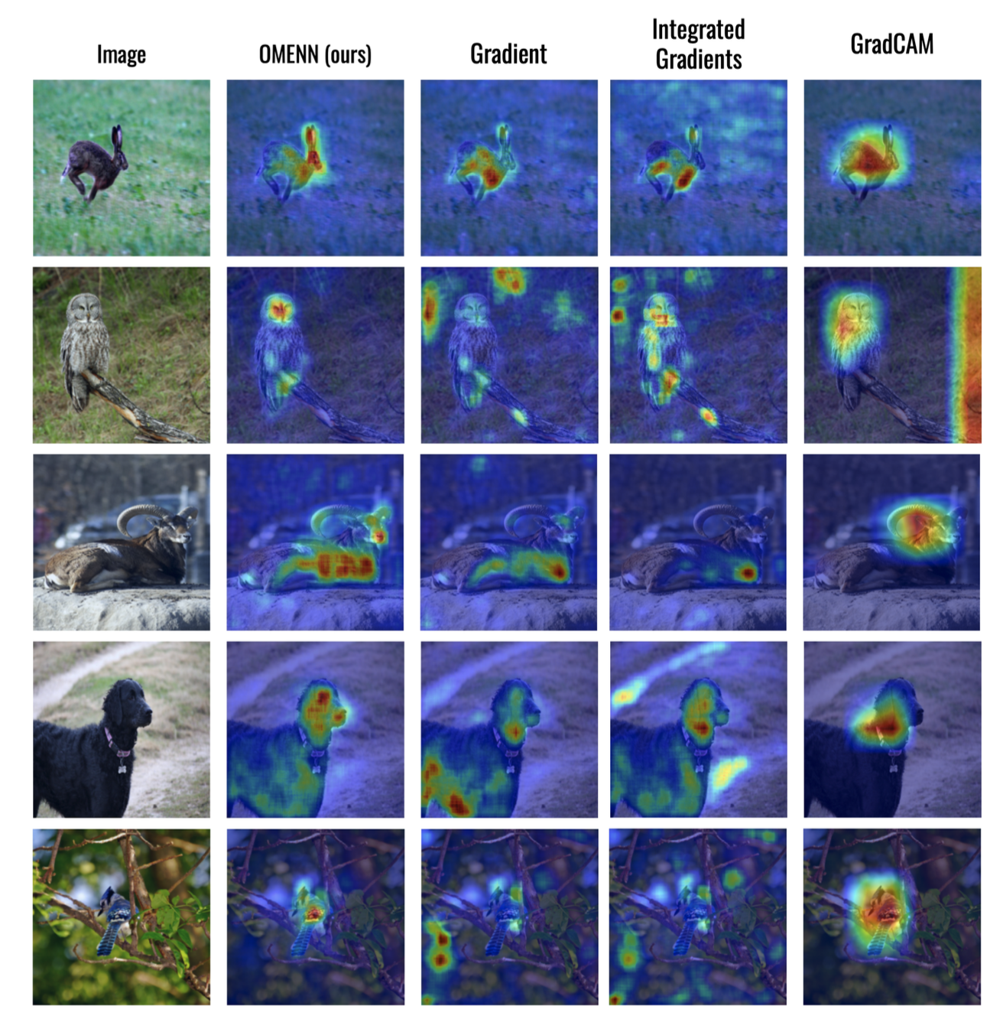
Results - Visual
Visual comparison to other XAI methods with ConvNext backbone.

Slide 32
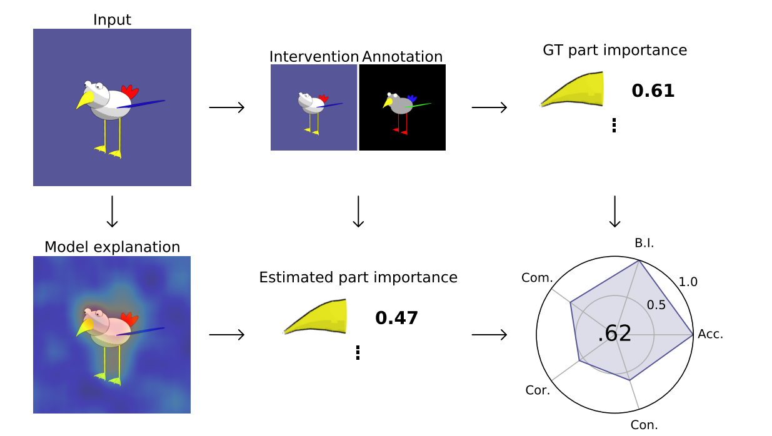
Results - FunnyBirds Benchmark
A synthetic dataset with swapped body parts to create a ground truth.
Figure from: “FunnyBirds: A Synthetic Vision Dataset for a Part-Based Analysis of Explainable AI Methods”

Slide 33
Results - FunnyBirds Benchmark
A synthetic dataset with swapped body parts to create a ground truth.
Evaluate if a method correctly identifies the features the model used.
Figure from: “FunnyBirds: A Synthetic Vision Dataset for a Part-Based Analysis of Explainable AI Methods”

Slide 34
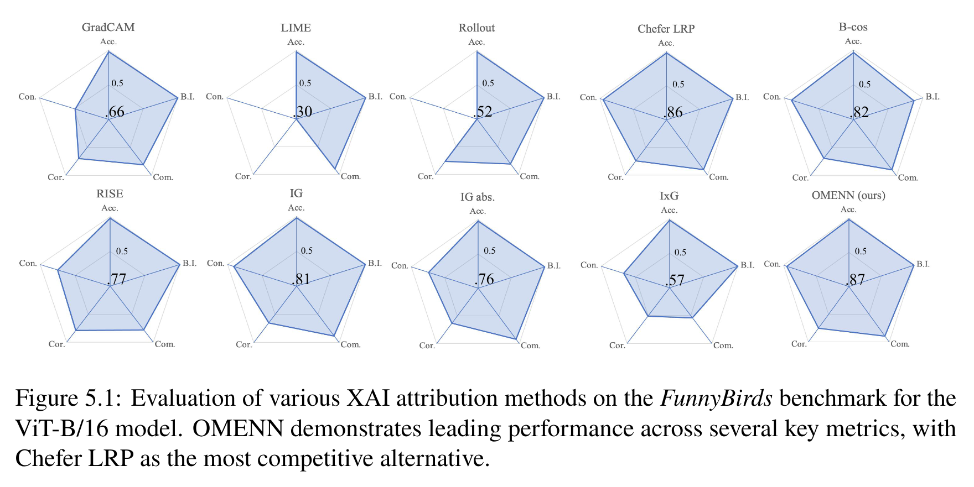
Results - FunnyBirds Benchmark

Slide 35
Conclusions

Slide 36
Conclusion
OMENN is a novel post-hoc attribution method which visualizes the network contributions, leveraging input-dependent linearity.
Achieves competitive performance to state-of-the-art attribution methods, even surpassing them in some configurations.
Demonstrated Broad Applicability to modern architectures like Vision Transformers and Convolutional Neural Networks.

Slide 37
Acknowledgements
The research was carried out for the project ”Interpretable and Interactive Multimodal Retrieval in the Drug Discovery” (grant no. FENG.02.02-IP.05-0040/23) within the First Team FENG programme of the Foundation for Polish Science co-financed by the European Union under the European Funds for Smart Economy 2021-2027 (FENG).
We gratefully acknowledge Polish high-performance computing infrastructure PLGrid (HPC Center: ACK Cyfronet AGH) for providing computer facilities and support within computational grant no. PLG/2023/016555.

Slide 38
Thank you for your attention!

Slide 39

Questions?
Connect on LinkedIn!
LinkedIn: janumiko
GitHub: janumiko
Email: contact@janumiko.com
Paper (on arxiv): arxiv.org/pdf/2412.02399
“One Matrix To Explain Neural Networks”

